Slide 1
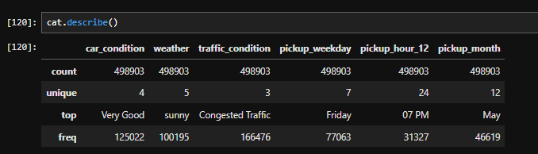
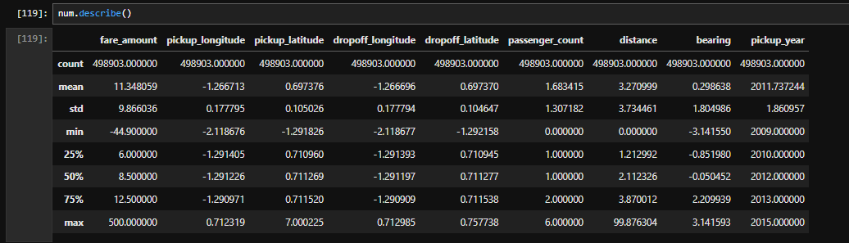
Uber Rides EDA Insights
Exploratory Data Analysis Summary

Slide 2
Understanding Uber Ride Patterns
Content:
Objective:
Analyze Uber ride data to uncover trends and insights.
Key focus areas:
Pricing, Fare amount, weather impact, and location-based analysis.

Slide 3
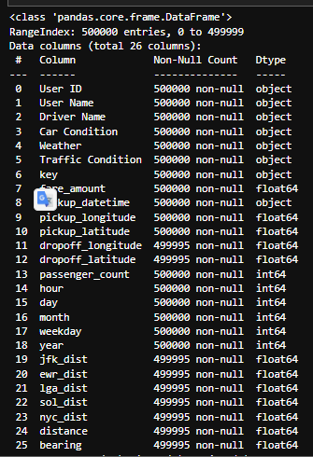
Data Cleaning & Preprocessing
Content:
Removed missing & duplicate values.
Converted pickup time to readable formats.
Filtered unrealistic fare values.

Slide 4
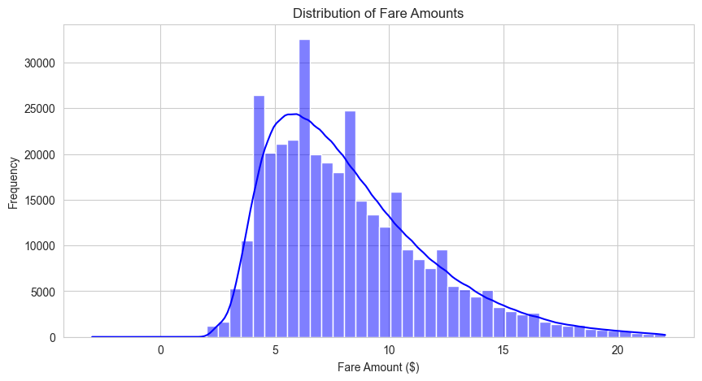
What is the distribution of Uber ride fares?
Content:
Most fares are low ($5-$20), with some high-value outliers.
Outliers could indicate long-distance rides or surge pricing.
Visualization: Histogram of fare distribution.

Slide 5
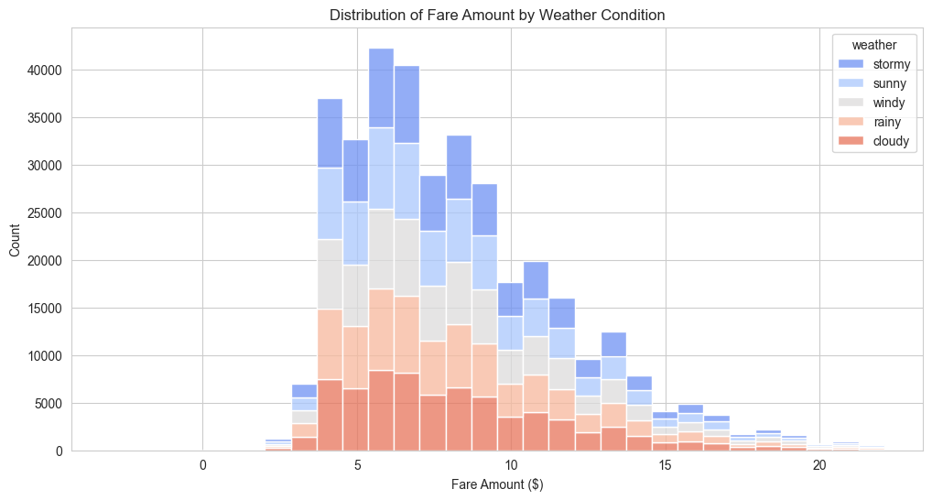
How does weather affect Uber fares?
Content:
Rainy/extreme weather conditions lead to higher fares.
Surge pricing is triggered by increased demand.
Visualization: hist-plot comparing fares by weather type.

Slide 6
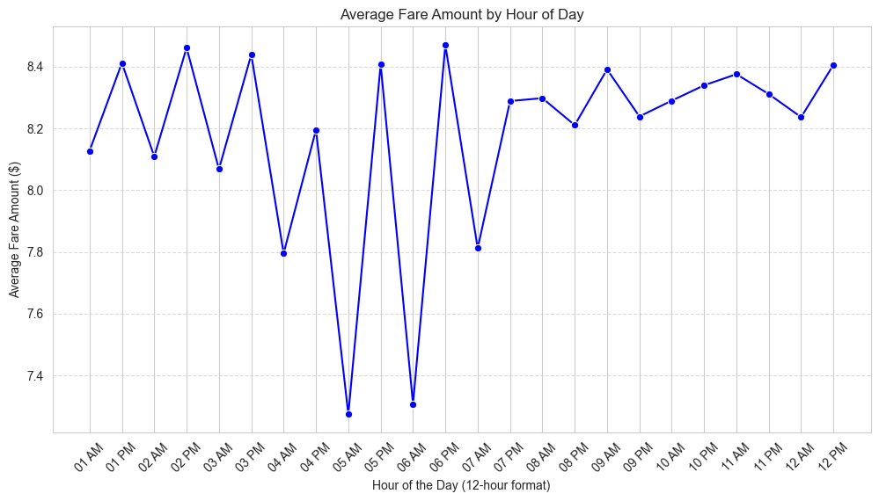
What are the busiest pickup hours?
Content:
Peak demand: Morning (7-9 AM) & Evening (5-8 PM).
Moderate activity late at night (10 PM-12 AM).
Visualization: Line chart of ride count by hour

Slide 7
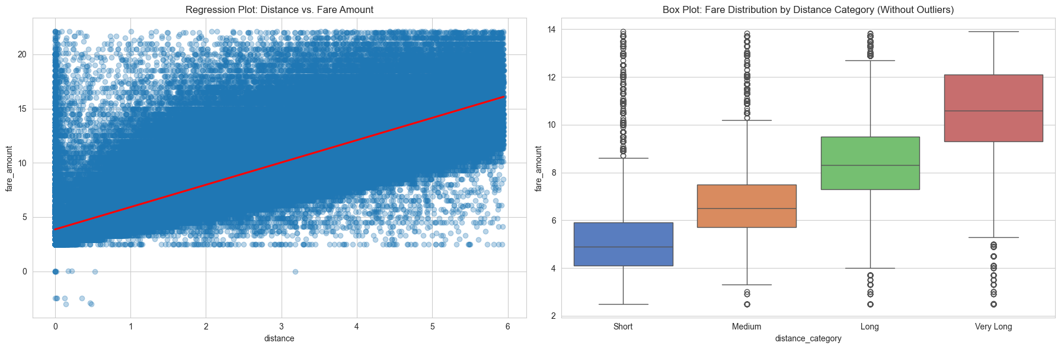
How does traffic congestion impact fares?
Content:
Higher congestion = longer ride times = higher fares.
Visualization: Scatter plot & box plot of fare amount vs. trip duration.

Slide 8
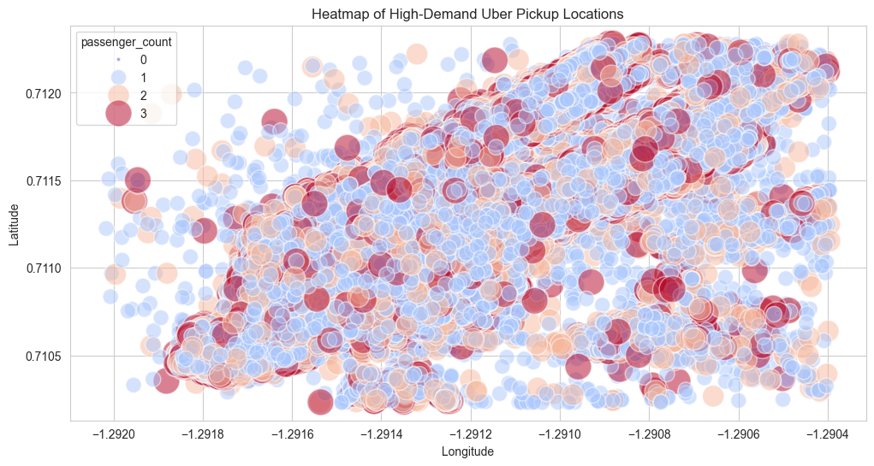
Heatmap of High-Demand Uber Pickup Locations

Slide 9
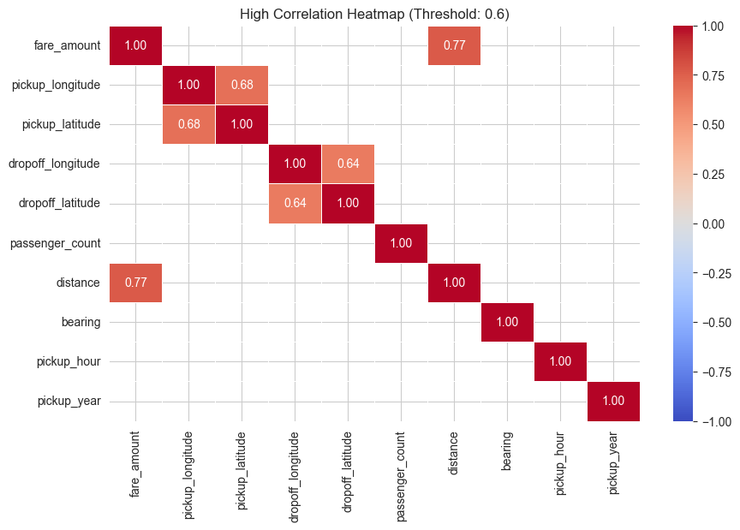
Data correlations
threshold = 0.6

Slide 10
Conclusion & Key Takeaways
Content:Weather, time of day, and location impact Uber fares.
Peak hours and high-demand areas drive pricing.
Data cleaning is essential for accurate insights.

Slide 11
Thank You!

